Slide 1
Caesar Cipher Project
A PRESENTATION ON

Slide 2
ABSTRACT
The Caesar Cipher project using Python and Tkinter is a GUI application that encrypts and decrypts text messages using the Caesar Cipher algorithm. It provides an easy-to-use interface where users can input text and specify the shift value. The program performs the encryption or decryption operation and displays the result on the screen. It includes error handling, a clear button, and a copy button for enhanced usability. Overall, it's a user-friendly tool for simple encryption and decryption using the Caesar Cipher.

Slide 3
Introduction
The Caesar Cipher project implemented using Python and Tkinter is a graphical user interface (GUI) application that allows users to encrypt and decrypt text messages using the Caesar Cipher algorithm. With an intuitive interface, users can input their text and specify the shift value, and the program quickly performs the encryption or decryption operation. It provides an accessible tool for individuals interested in cryptography or seeking a simple encryption solution.

Slide 4
Existing Method
The existing method in the Caesar Cipher project involves implementing the Caesar Cipher algorithm using Python and Tkinter. It allows users to encrypt and decrypt text by shifting each letter in the message based on a specified shift value. The program provides a user-friendly interface for inputting the text and shift value, performs the encryption or decryption operation, and displays the result on the GUI. Error handling, clear functionality, and a copy button are included for enhanced usability.

Slide 5
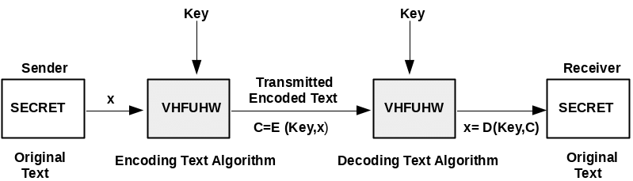
Proposed method with Architecture
Block Diagram

Slide 6
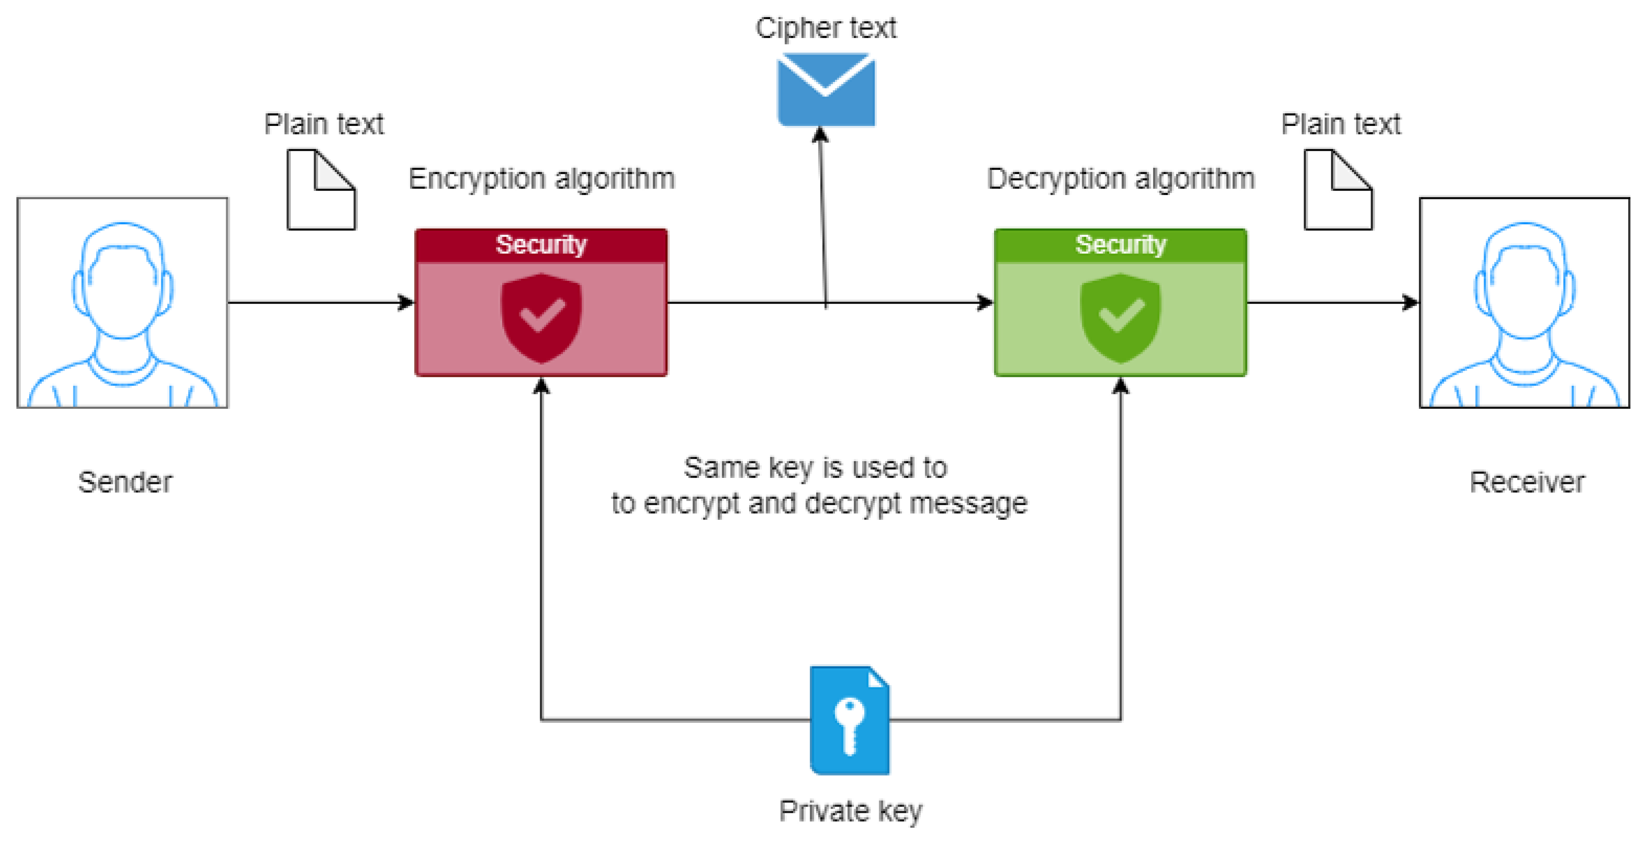
Proposed method with Architecture
System Architecture

Slide 7
Methodology
- Design a GUI using Tkinter for user interaction.
- Validate user input to ensure it only contains alphabetic characters and a valid shift value.
- Implement the Caesar Cipher algorithm to encrypt the input text by shifting each letter forward by the specified shift value.
- Implement the reverse process of the Caesar Cipher algorithm to decrypt the encrypted text.
- Handle errors by displaying appropriate error messages for invalid inputs.
- Display the encrypted or decrypted text as the output.
- Provide a clear button to reset the input fields.
- Include a copy button for easy copying of the resulting text.
- Ensure a user-friendly and intuitive interface for a seamless experience.

Slide 8
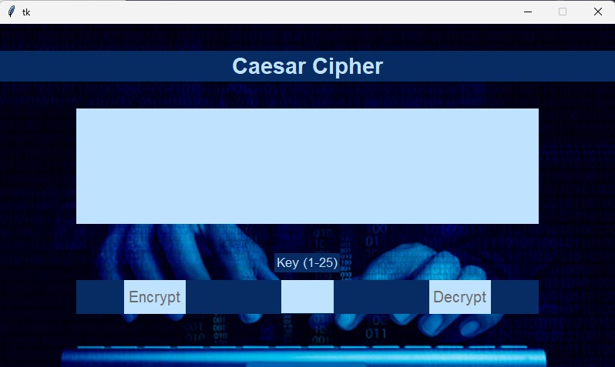
Implementation
GUI of project

Slide 9
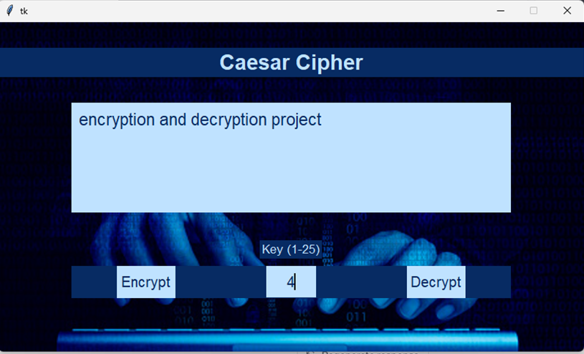
Encrypting Text

Slide 10
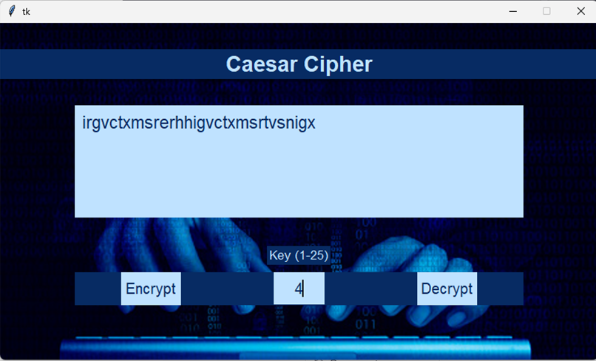
Encrypted Text

Slide 11

Decrypted Text

Slide 12
Implementation
1. Create a Tkinter GUI with input fields, buttons, and a text area.
2. Retrieve user input for the text and shift value.
3. Validate the input for alphabetic characters and a valid shift value.
4. Implement encryption by shifting each letter forward based on the shift value.
5. Implement decryption by shifting each letter backward.
6. Handle errors with appropriate error messages.
7. Display the result in the text area.
8. Include a clear button to reset the input fields.
9. Add a copy button for easy text copying.
10. Test the application for functionality and edge cases.

Slide 13
Conclusion
The Caesar Cipher project implemented using Python and Tkinter provides a user-friendly interface for encrypting and decrypting text messages using the Caesar Cipher algorithm. Through the use of Tkinter, users can input their text and specify the shift value easily. The program effectively performs the encryption or decryption operation and displays the result on the screen. With error handling, clear functionality, and a copy button, the project ensures a seamless and intuitive user experience. Overall, the project offers a practical tool for basic encryption and decryption using the Caesar Cipher algorithm.

Slide 14
Thank you

